Slide 1
Multi-sensor rail track detection in automatic train operations
Master’s thesis in Data Science
Student: Attila Kovacs
1st Advisor: Lukas Rohatsch (FH Technikum)
2nd Advisor: Daniele Capriotti (M2C Expert Control GmbH)
Alignment: 17.01.2024

Slide 2
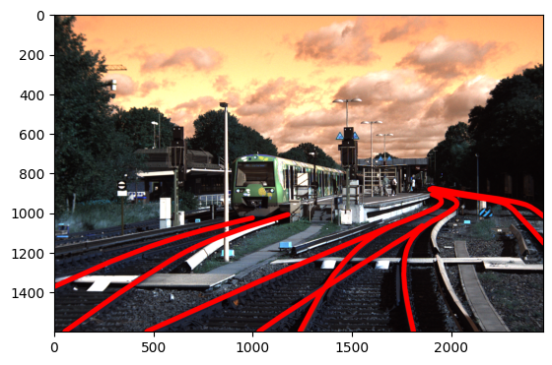
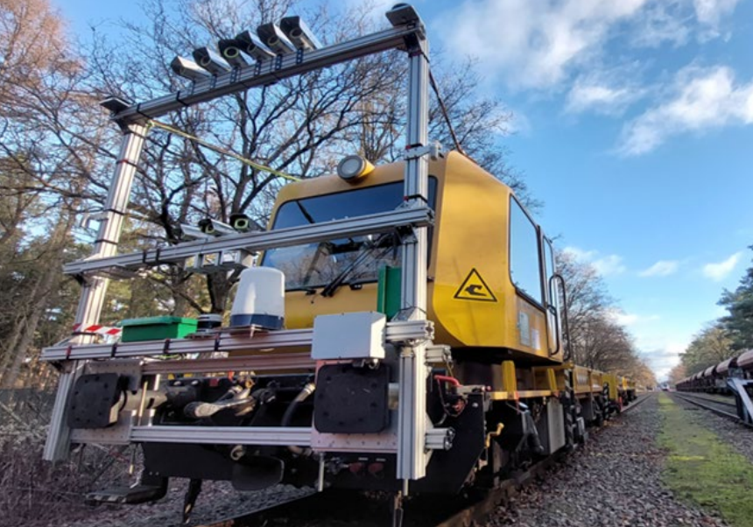
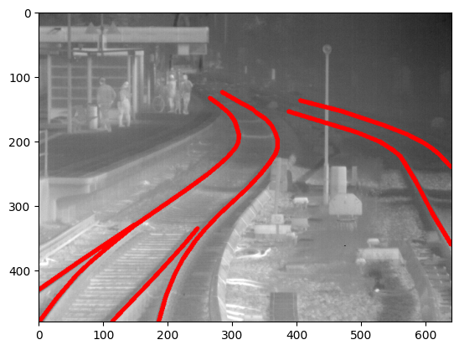
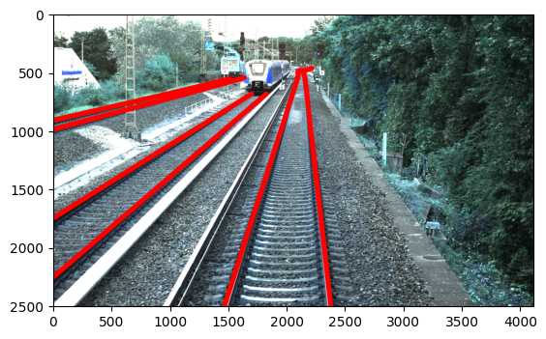
Problem setting
What is Automatic train operations (ATO) Technology is used to automate tasks that were previously performed by rail personnel (e.g., conductor)

Slide 3
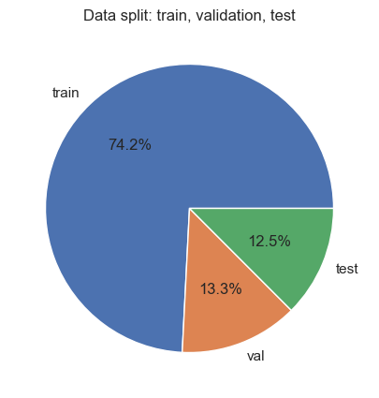
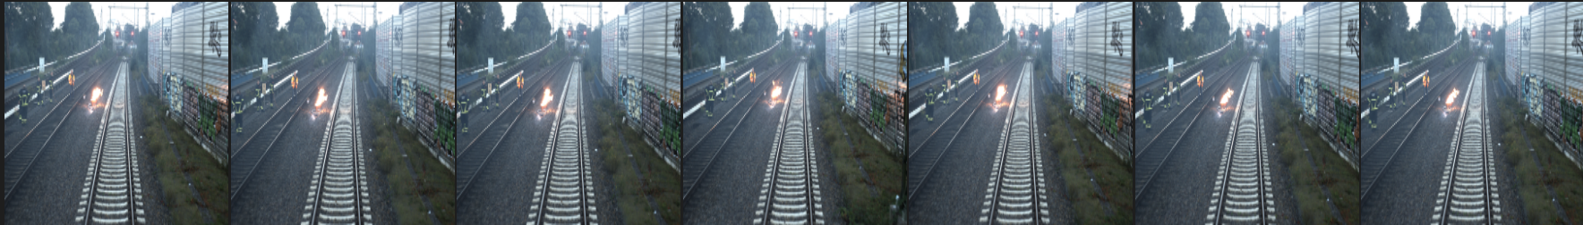
Dataset generated by Deutsche Bahn
Multisensor dataset
Infrared
RGB 5MP
RGB 12MP
Left, right, and center, respectively
Large similarity between frames of video → split on videos → add other datasets during training process

Slide 4
Modelling rail detection as segmentation
Semantic segmentation → deep learning algorithm that associates a label or category with every pixel in an image
Distinguish background pixels and track pixels
Baselining by traditional image processing approach based on gradient thresholding

Slide 5
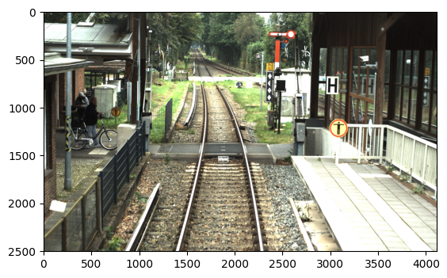
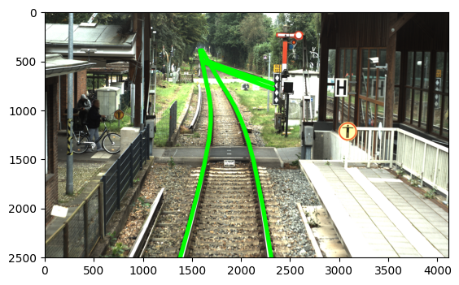
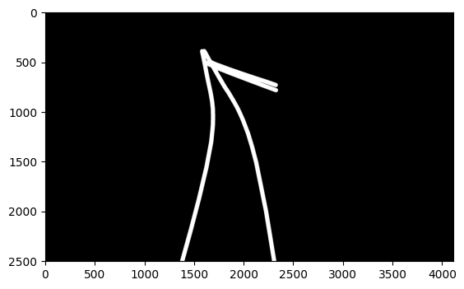
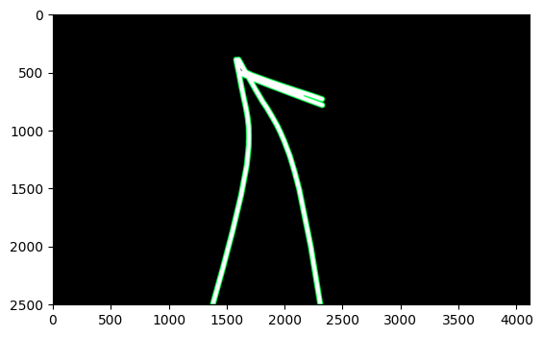
Modelling rail detection as segmentation
Original image
Labels are polylines
Mask
Mask with contour
Contour = Label
0 0.0515625 0.24166666666666667 0.046875 0.24375 0.0453125 0.24791666666666667 0.0515625 0.25625 0.1296875 0.2916666666666667 0.1734375 0.31666666666666665 0.1890625 0.3333333333333333

Slide 6
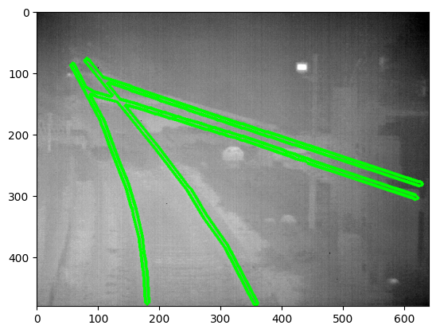
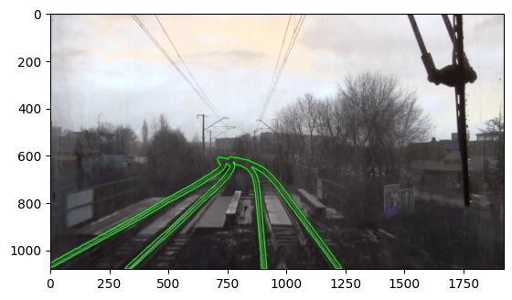
Modelling rail detection as segmentation
Example IR
Example RailSem

Slide 7
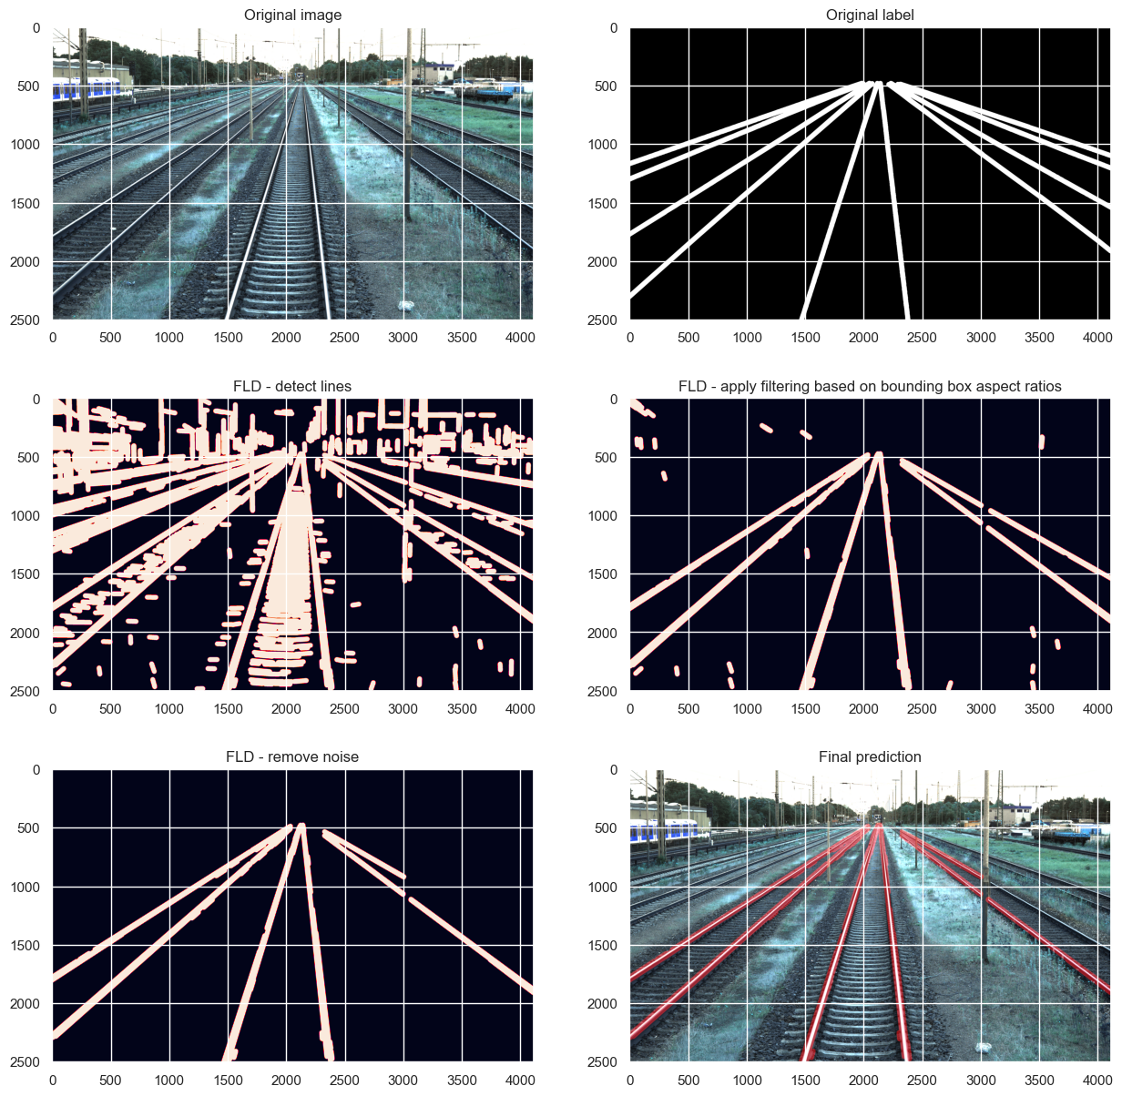
Baselining with fast line detection (FDL)

Slide 8
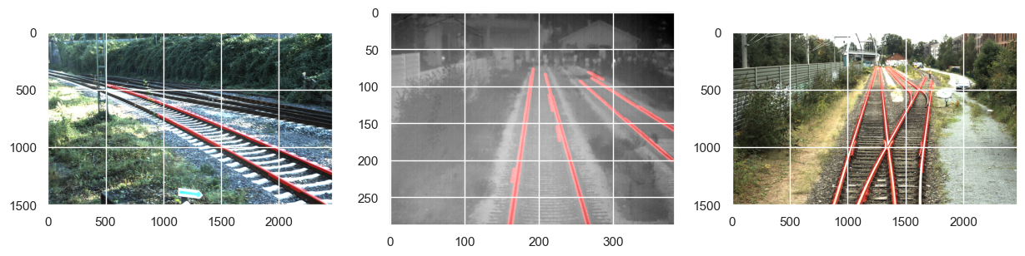
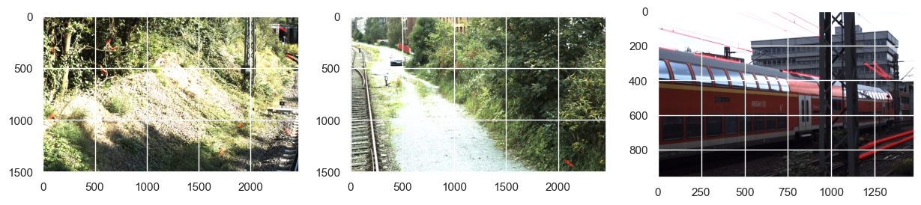
Baselining with fast line detection Good examples and bad examples

Slide 9
Deep learning approach
YOLOv8 as framework
Can be used for segmentation and object detection
State-of-the-art computer vision model built by Ultralytics
Easy to use
Open source

Slide 10
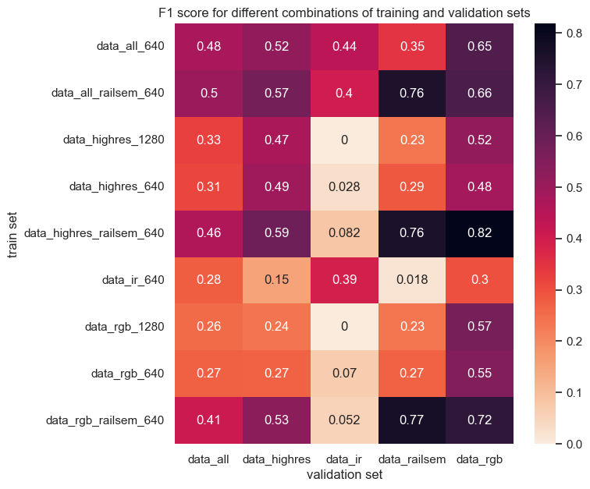
9 models have been trained and validated

Slide 11
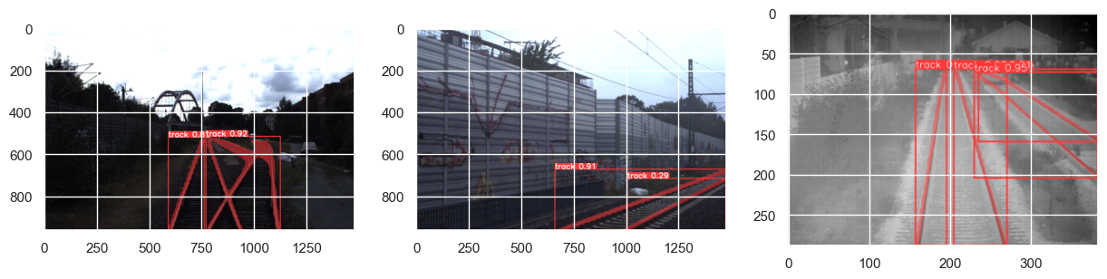
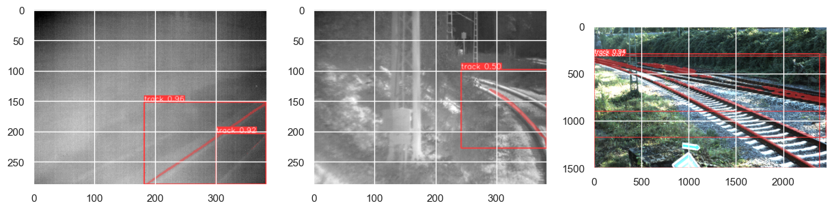
YOLO Good examples and bad examples

Slide 12
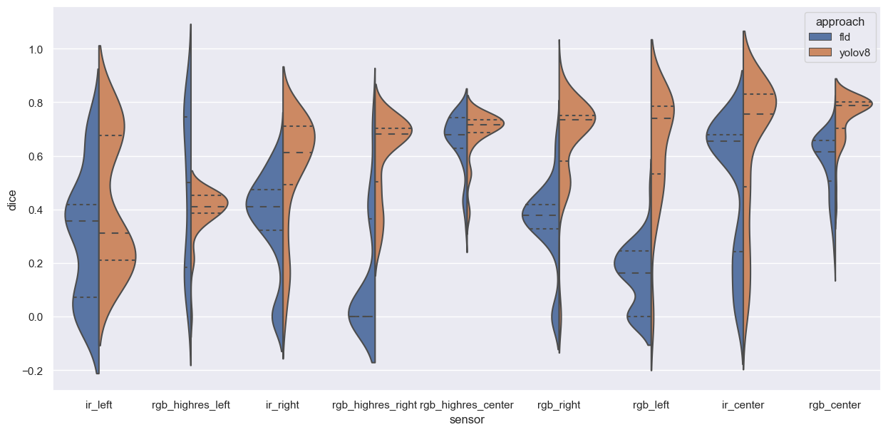
YOLOv8 vs FDL Performance on validation data

Slide 13
Conclusion
Image segmentation seems to be a proper approach for modelling and solving the rail track detection problem
Fast line detection provides a solid baseline, however YOLO outperforms FDL in most scenarios
It seems that the performance across different sensors is similar – the orientation of the sensors has a larger impact on the results
YOLO is well suited to be applied in real life due to fast inference

Slide 14
Timeline
Sep 23
Oct 23
Nov 23
Dec 23
Jan 24
Feb 24
Mar 24
Apr 24
May 24
Jun 24
DSP Kick-off
Exploratory Data Analysis
Literature Review
Base Model Selected
Establishing Baseline (CV2)
Model Finetuning
Result Analysis and Documentation of Approach
First Version Ready
Final Version Ready
Master‘s Exam

Slide 15
Thank you!

